Slide 1
Studying at University in Belgrade before and during Bologna process
Dušan Tošić
University of Belgrade, Faculty of mathematic

Slide 2
Agenda
Introduction (History)
Studies in Serbia
Studying at University of Belgrade before Bologna process
Start of Bologna process
Some results of Bologna studying at University of Belgrade
Conclusion

Slide 3
1. Introduction
Some of data related to Bologna Process (BP) are presented in the following table:
Year | Event
2003 | Serbia joined the Bologna Process
2005 | Approved the Law on Higher Education
2005 | Founded: National council for higher education and Commission for accreditation and quality assurance
2007 | Started accreditation process
2008 | Three cycle system and ECTS are implemented in all study programs
2010 | Changed the Law on Higher Education

Slide 4
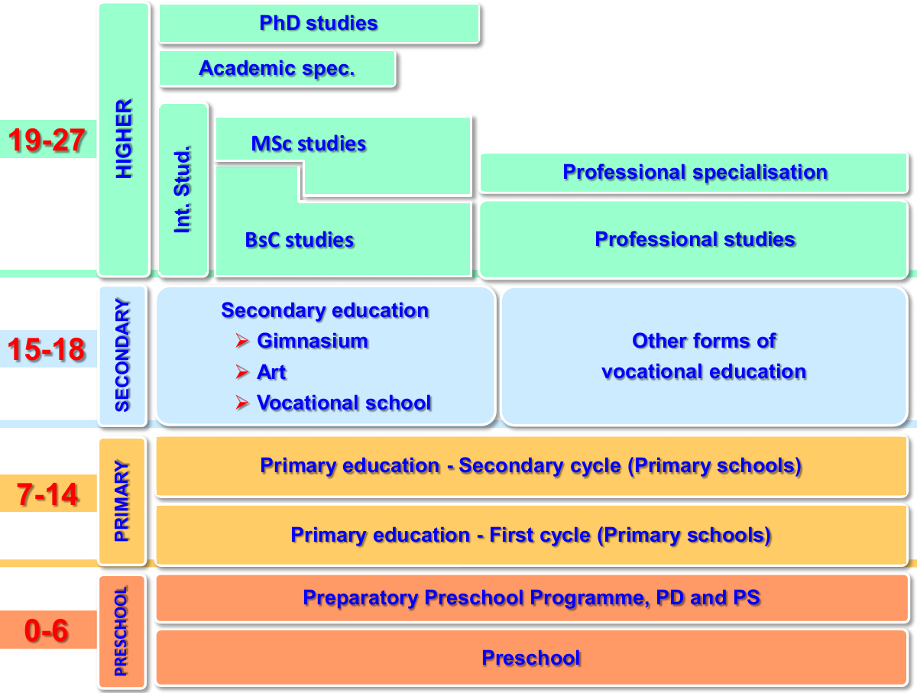
2. Studies in Serbia
(R. Mitrović: „Modernization of Higher Education System in Serbia“ )

Slide 5
3. Studying at University of Belgrade before Bologna process
Official duration of study was different, depending of faculty.
We have faculties with duration of: 4, 5 and 6 years.
After finishing undergraduate studies, students could continue MSc and PhD studies.
Schools of applied studies (colleges) are not included at University.

Slide 6
3.1. Real situation about studies at Universities in Serbia
According to I. Jarić and M. Vukasović („Bolonjska reforma visokog školstva u Srbiji: mapiranje faktora niske efikasnosti studiranja“).
From enrolled students, only 55% finished studies. Real duration of study is presented in the next table.
Officiel length of study | Average length of study
4 | 6.76
5 | 7.51
6 | 7.62

Slide 7
3.2. Additional characteristics
Length of the most courses was 2 semesters.
There were a lot of examination terms.
Students are not motivated to finish study (to enroll next year of study, student spent in average 1.45 years).

Slide 8
4. Start of Bologna process
Implementation started 2006 year.
Basic principles from Bologna Declaration are stated by Low:
Three cycle system (3+2+3 or 4+1+3)
ECTS
Transparency
Compatibility and comparability of diploma
….

Slide 9
4.1. Some of problems
Students were not ready to accept changes according to Bologna principles.
Professors were not ready, also. (The role of „old fashion“ professors.)
Serbian economy (and whole society) was not ready too.
Protests of students were organized.

Slide 10
4.2. Modification of Bologna principles
Politicians gave in students and the Law on Higher Education is changed.
6 examination terms are introduced (The idea was to reduce this number later. New changes in low introduced 5 examination terms.)
Students could enroll the next year with 45 ECTS. (The idea was to increase the number of ECTS periodically until 60. Now is actual number of 50 ECTS.)
The length of semesters is often reduced from 14 weeks to 13 or (even) 12.

Slide 11
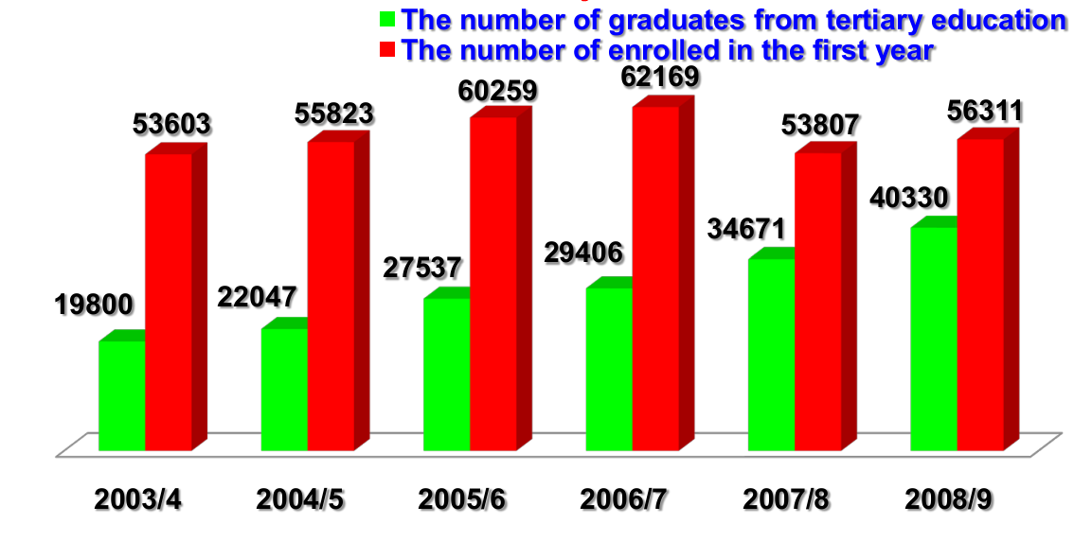
4.3. First results (from Ministry of Education and Science)

Slide 12
5. Some results of Bologna studying at University of Belgrade
Official statistical data are not available .
Partial reports (about exams in some faculties, on some year and so on) like this one:
Analiza_uspesnost_studiranja_Igodine_osn.ak.2006-07_dodatakESPB.pdf
could be obtained, but there are not overall data.
V. Dondur (Member of Bologna fellow group) presented the following facts (without specifying exact statistical data):

Slide 13
Average length of study is less than before BP.
Average mark is higher than before BP.
Continued estimation of students (and professors) is accomplished.
Number of students finishing studies is increased.
Number of enrolled students is (approximately) same.
Passing of crucial courses is increased (for 13% of course before BP passing was 30%, and now it is 5%).

Slide 14
5.1. Shortcomings
Reduced the number of students studding according to „accelerated program“.
Mobility of students is almost impossible.
Obtained knowledge is often elementary without profound education (???).
Administrative work of professors is enlarged.

Slide 15
5.2. Personal observations
Students are more overloaded.
Average mark is higher than before BP.
Most students pass exams in the first examination term.
Presence of students at lectures is better then before BP.

Slide 16
6. Conclusion
Bologna process advances (slowly) in Serbia.
We are still in period of adaptation, improvement is made step by step.
First results (at University of Belgrade) are promising.
New generations of professors (educated in line with Bologna principles ) are coming.

Slide 17
Thank you!

